Slide 1
Visual Builder Redwood POC’s for Fusion SaaS
© 2025-August

Slide 2
Summary of Redwood POC’s as of July 2025
Code and documents provided in : https://github.com/juanjesusmontero/oracle_redwood_cookbook
Module | Title
SCM | Sales Order. Query page with hash keys | 1
SCM | Sales Order. Query page that run some process | 2
SCM | Transfer Orders. Query page to update some field. | 3
Procurement | Purchase Requisitions. Query Page | 4
Receivables | Invoices. Query page to update Flexfields | 5
Procurement | Suppliers. Basic creation page | 6
SCM | Work orders. | 7
SCM | Redwood Custom pages to scan a EAN13 barcode with mobile or PWA device. | 8
SCM | Sales Order. ADF Classic page. Run OIC integration from button. | 9. NEW 1
HCM | Person Results. Basic page to show feasibility to clone standard with our requirements | 10. NEW 2
Receivables | Transactions. Export to csv 10.000+ records. WIP. | 11. NEW 3
Procurement | Suppliers. Import and show in Redwood page 500+ UDAs (User defined attributes) | 12. NEW 4

Slide 3
Redwood POC’s as of August 2025 Code and documents. Part 1.
 | Module | Title | Document and code
 | SCM | Sales Order. Query page with hash keys | Redwood_cookbook_2026_SCM_SALES_ORDERS_HASH.pdf OIC VB-Code: XX_DEMO_SCM_SALES_OR-1.0.zip OIC Integration: XX_GET_SO_HASH_LINE_01.00.0001.iar
 | SCM | Sales Order. Query page that run some process | Oracle Visual Builder Redwood Cookbook 2026_chapter_27.pdf OIC VB-Code: blog_01_part3_fra_demo-redwood-01_19323_1-1.0.zip
 | SCM | Transfer Orders. Query page to update some field | VB_REDWOOD_COOKBOOK_2026_TRANSFER_ORDERS.pdf OIC VB-Code: XX_DEMO_TRANSFER_ORDERS-1.0.3.zip
 | Procurement | Purchase Requisitions. Query Page | VB_REDWOOD_COOKBOOK_2026_scm_po_req_NEW_PAGE.pdf OIC VB-Code: XX_PO_REQ_DEMO_QUERY-1.0.7.zip
 | Receivables | Invoices. Query page to update Flexfields | Not provided.
 | Procurement | Suppliers. Basic creation page | Doc. Provided in book Oracle Visual Builder Redwood Cookbook 2025 Chapter 23. OIC VB-Code: 23_SAAS_SUPPLIERS_103-1.0.zip
 | SCM | Work orders | Redwood_cookbook_2026_SCM_WORK_ORDERS_QUERY_DFF.pdf OIC VB-Code: XX_OIC_VB_DEMO_WORK_ORDERS-1.0.1.zip XX_EXTENSION_WORKPACE_DEMO_WORK_ORDERS_v4.zip
 | SCM | VB Redwood pages to scan a EAN13 barcode with mobile or PWA device. | Redwood_CookBook 2026 SCM ITEM SCANNER Part II.pdf Extension VB code: Redwood_CookBook 2026_workspace_dev4_scan_v01.zip

Slide 4
Redwood POC’s as of August 2025 Code and documents. Part 2
 | Module | Title | Document and code
 | SCM | Sales Order. ADF Classic page. Run OIC integration from button. | Redwood_Cookbook_2026_scm_so_show_in_ADF_and_OIC 1.0.pdfXX_DEMO_CALL_OIC_FROM_VB_01.00.0000.iar Redwood_Cookbook_2026_scm_so_show_in_ADF_and_OIC_call 5.0.zip
 | HCM | Person Results. Basic page to show feasibility to clone standard with our requirements | Redwood Cookbook 2026_HCM_PERSON_RESULTS.pdf XX_HCM_PERSON_RESULTS-1.0.1.zip
 | Receivables | Transactions. Export to csv 10.000+ records. WIP. | Redwood_cookbook_2026_AR_TRX_20K_EXPORT.pdf XX_AR_TRX_20K_EXPORT-1.0.3.zip
 | Procurement | Suppliers. Import and show in Redwood page 500+ UDAs (User defined attributes) | Redwood_cookbook_2026_SUPPLIERS_EXTENSIBLE_FLEXFIELDS_v1.pdf XX_SUPPLIER_EXTENSIBLE_FLEX-1.0.zip

Slide 5
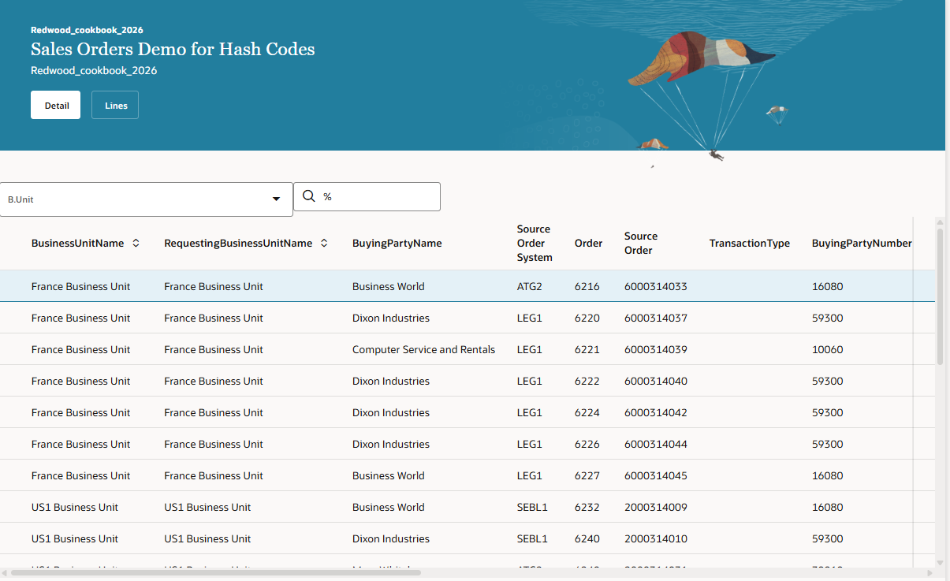
SCM. Sales Order. (1)
First level. Sales Order headers.
Basic filter for Business Unit/Order

Slide 6
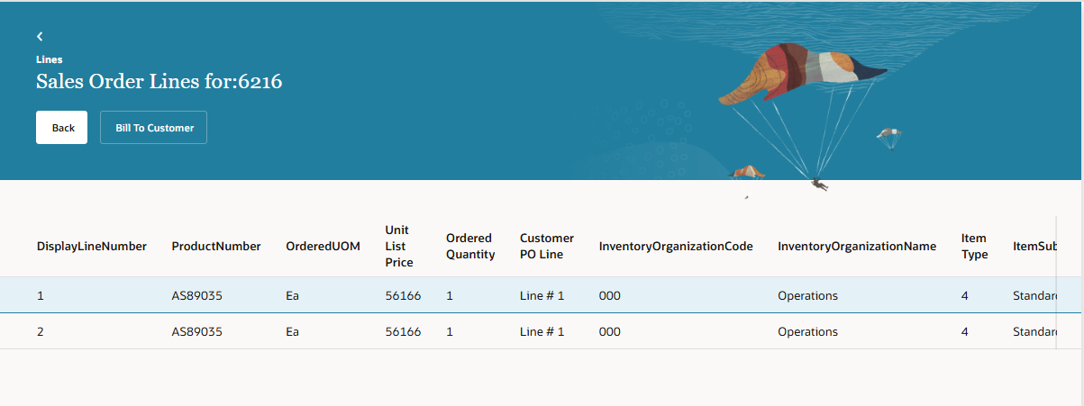
SCM. Sales Order. (1)
Second level. Sales Order Lines.

Slide 7
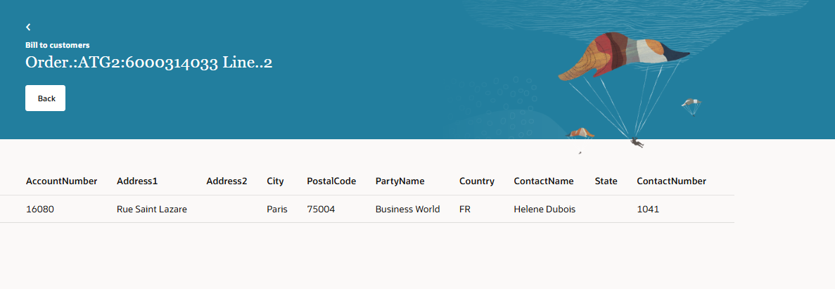
SCM. Sales Order. (1)
Third level. Bill to data for a sales order line.

Slide 8
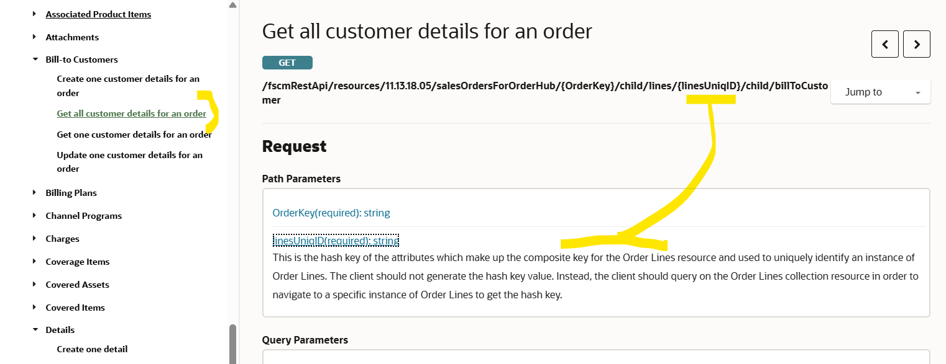
SCM. Sales Order. (1)
Hash codes basics.

Slide 9
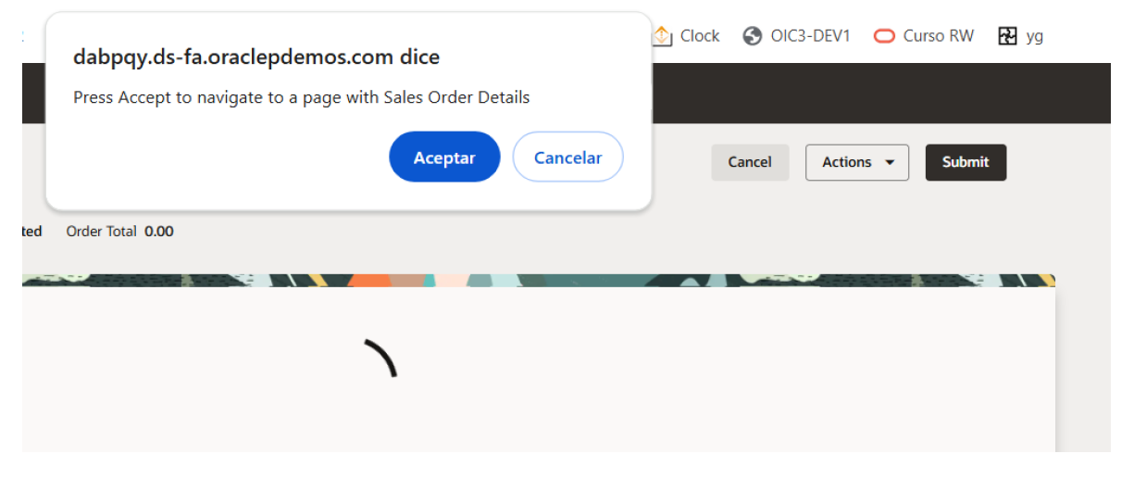
SCM. Sales Order. (2)
Summary: starting navigation from Redwodd Sales Orders page we will access a new VB page extension master detail, able to run any REST API process.
Here we show how to access the new page after opening Sales Order page.

Slide 10
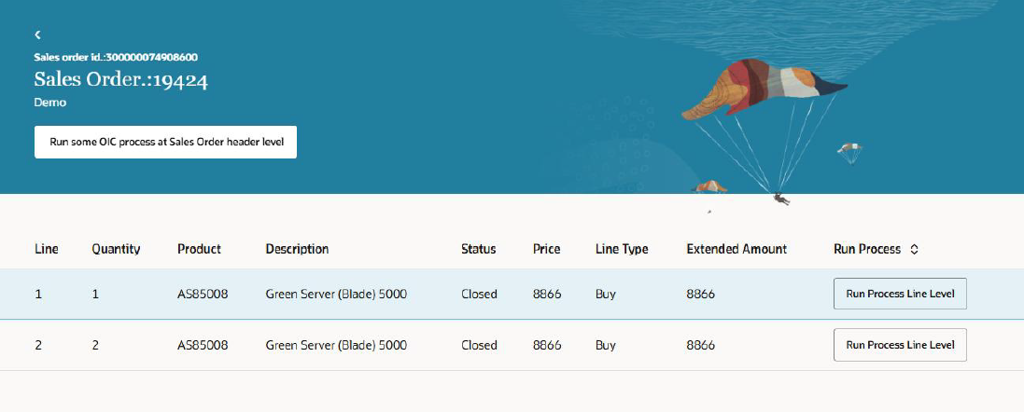
SCM. Sales Order. (2)
New page with process at header level or a line level could be accomplished.

Slide 11
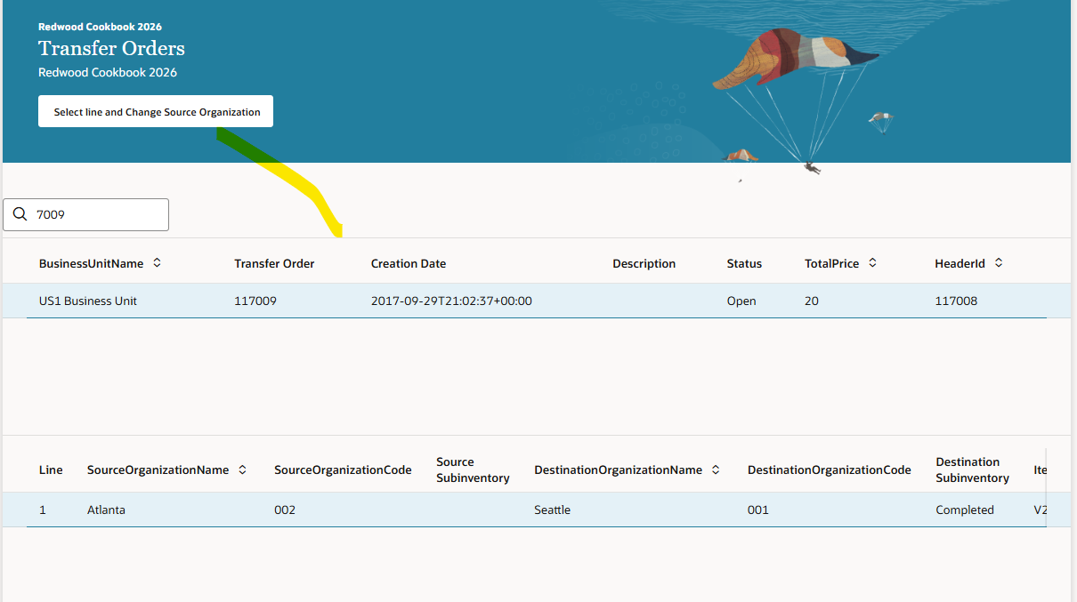
SCM. Transfer Order. (3)
Master-detail query in transfer orders to allow modify some data, clicking the button

Slide 12
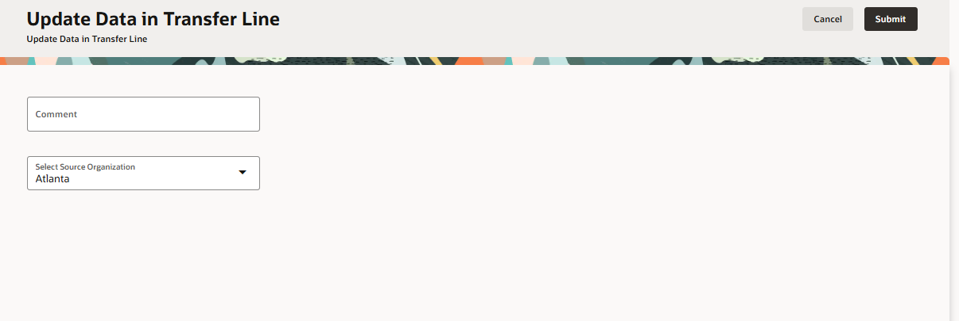
SCM. Transfer Order. (3)
Here it could be posible to update some data.

Slide 13
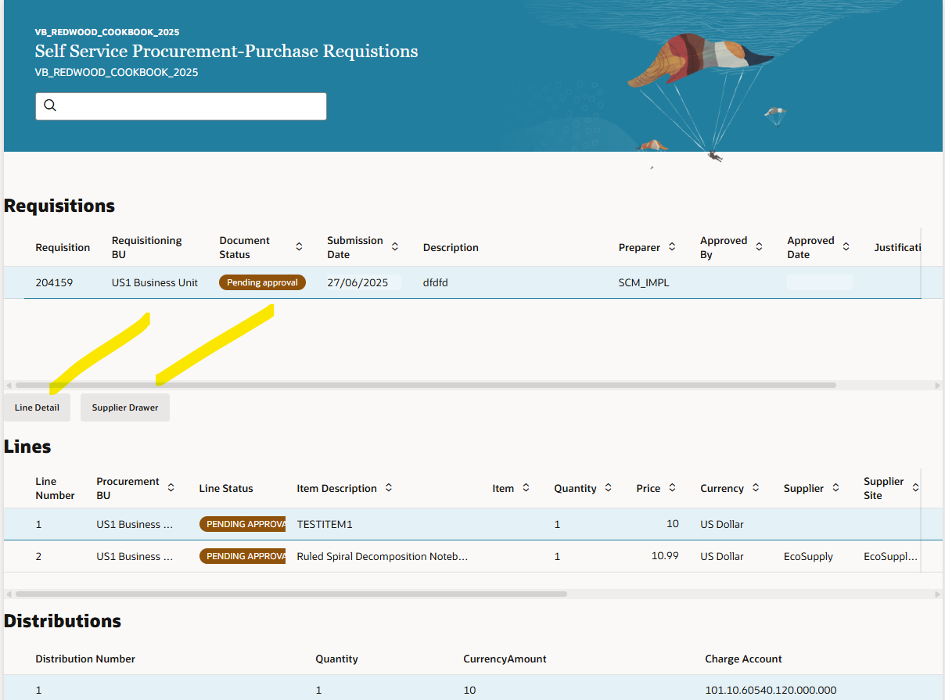
Procurement. Purchase Requisitions. (4)
Only query purchase requisitions
Including detail for line, using first button.
Including detail for supplier in a
Drawer, using second button

Slide 14
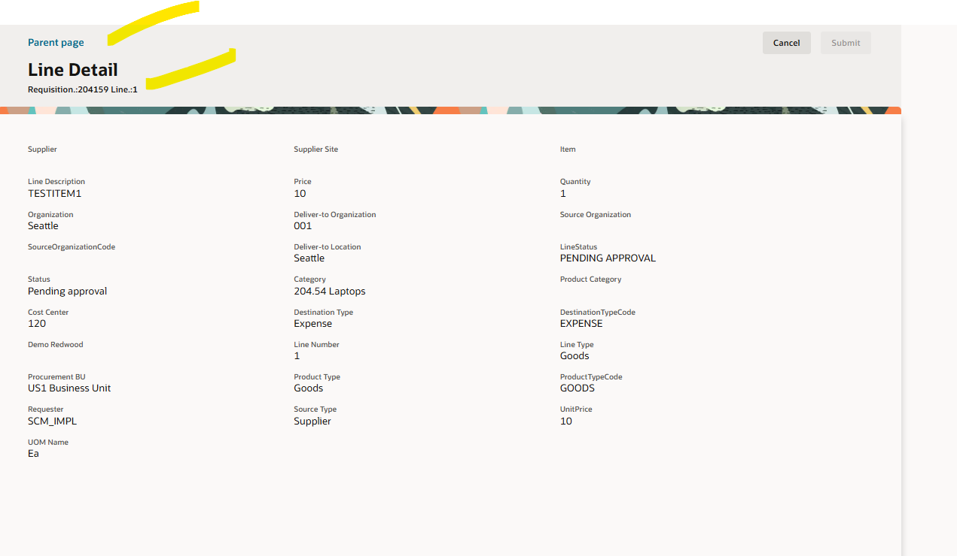
Procurement. Purchase Requisitions. (4)
Line requisition detail

Slide 15
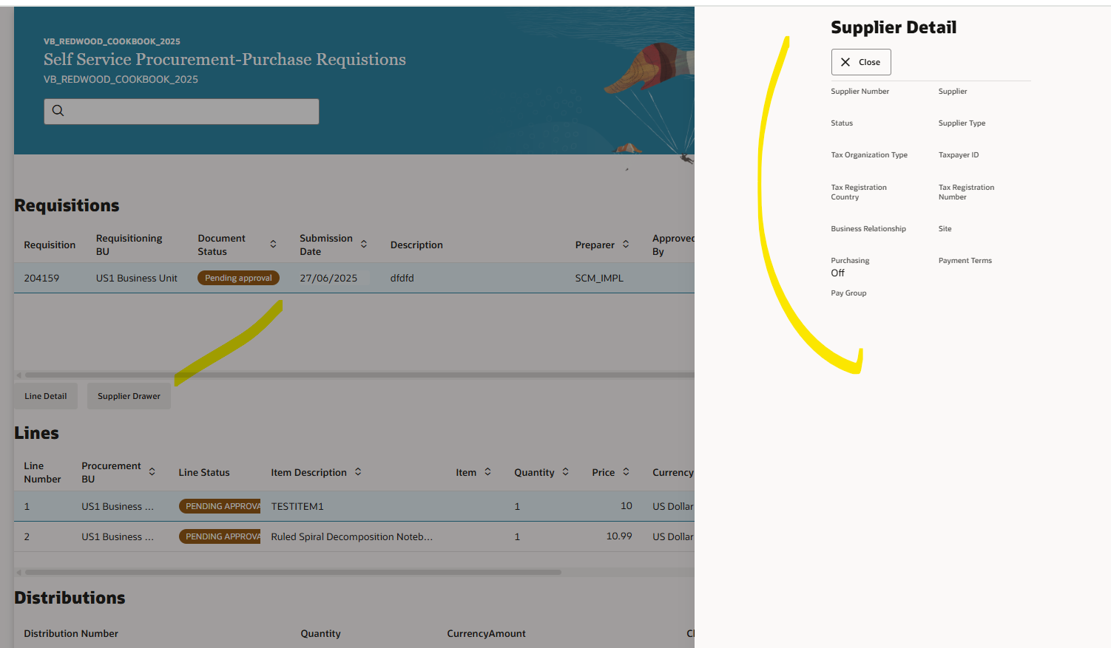
Procurement. Purchase Requisitions. (4)
Supplier detail in Drawer Popup

Slide 16
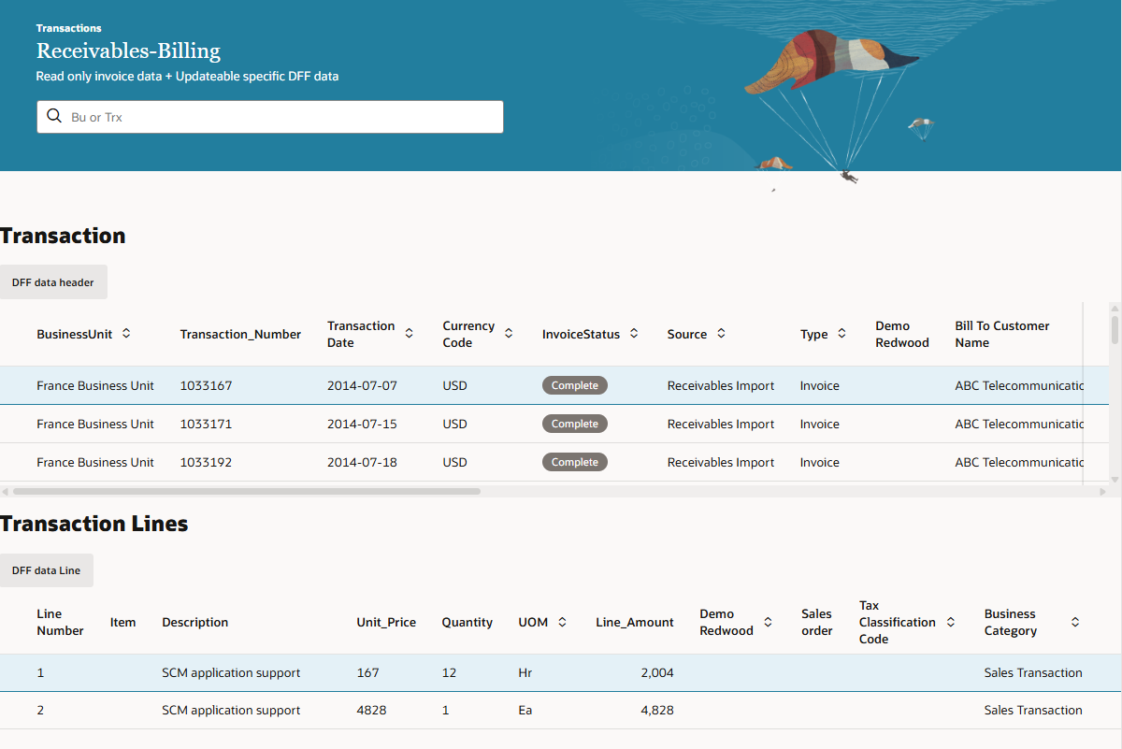
Receivables. Invoices. (5)
Here we allow DFF update in receivables transactions, in headers

Slide 17
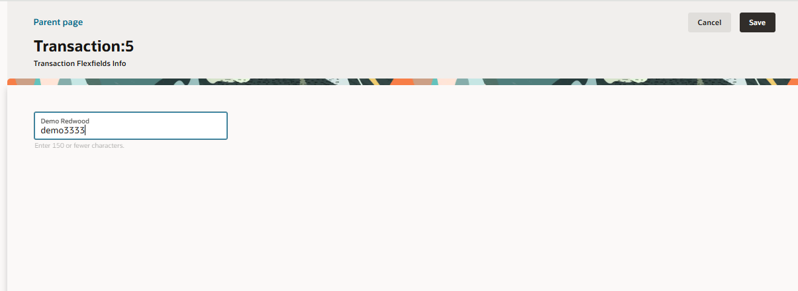
Receivables. Invoices. (5)
Here the user could update the DFF fields as per requirements

Slide 18
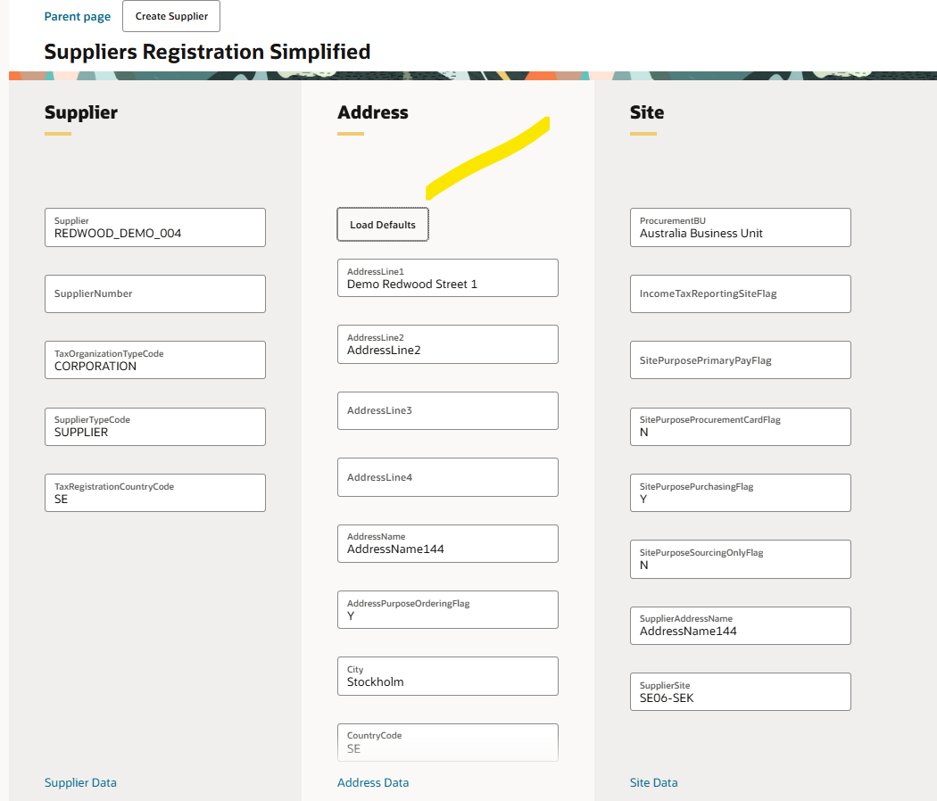
Procurement. Suppliers. (6)
Simplified page to create suppliers
with basic, minimum data.
Goal speed up the creation of suppliers with mínimum data.
Just to show it is feasible to create suppliers using standard REST API.

Slide 19
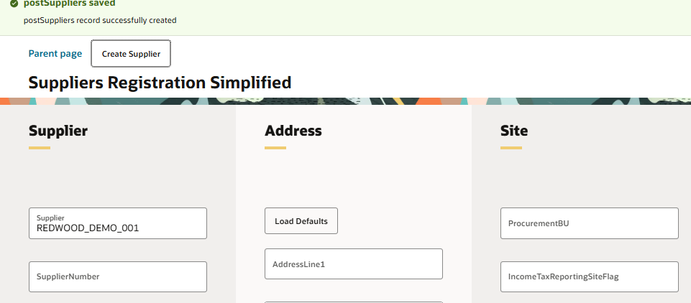
Procurement. Suppliers. (6)
Supplier created.

Slide 20
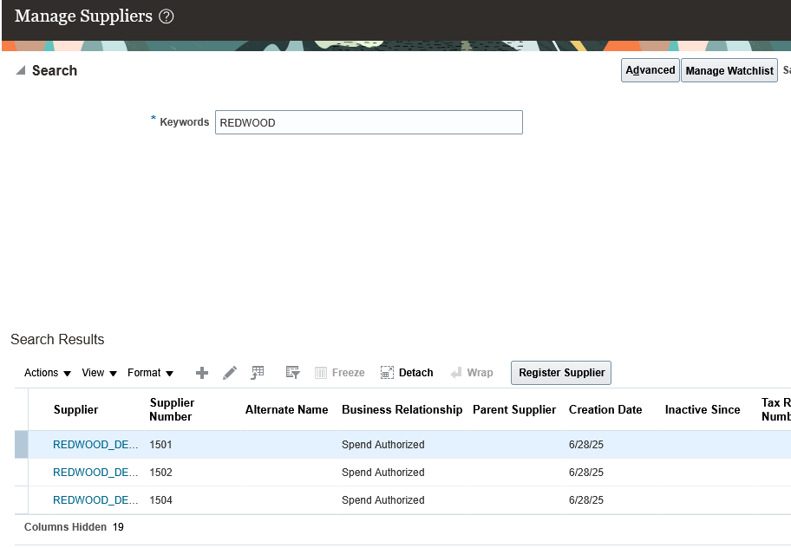
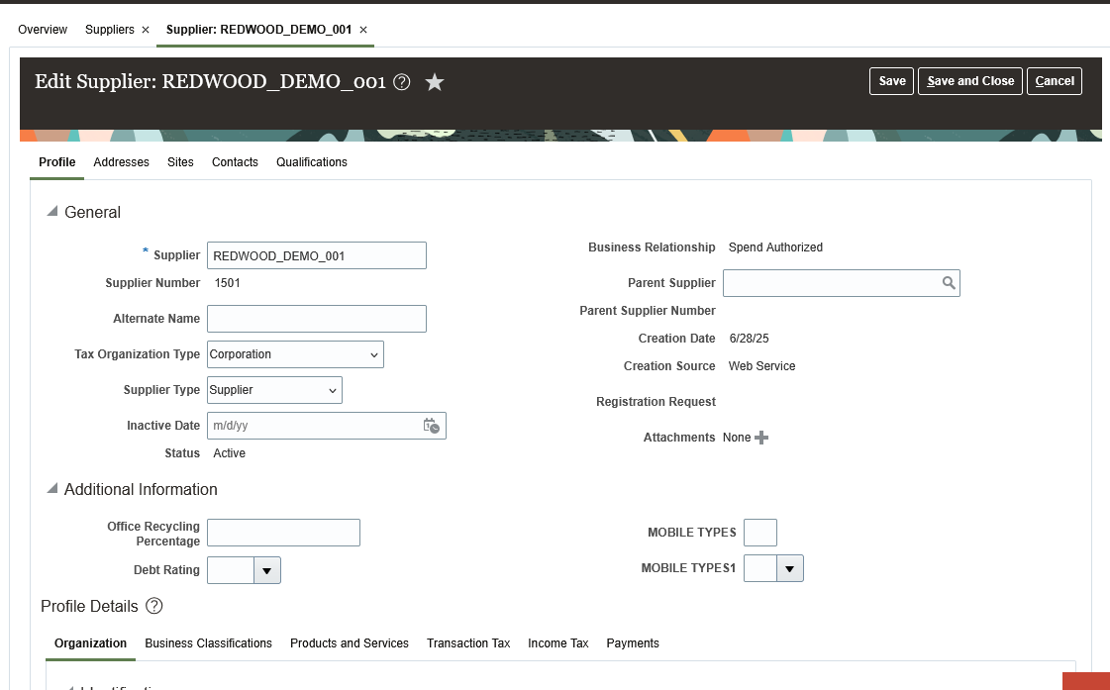
Procurement. Suppliers. (6)
Supplier created.

Slide 21
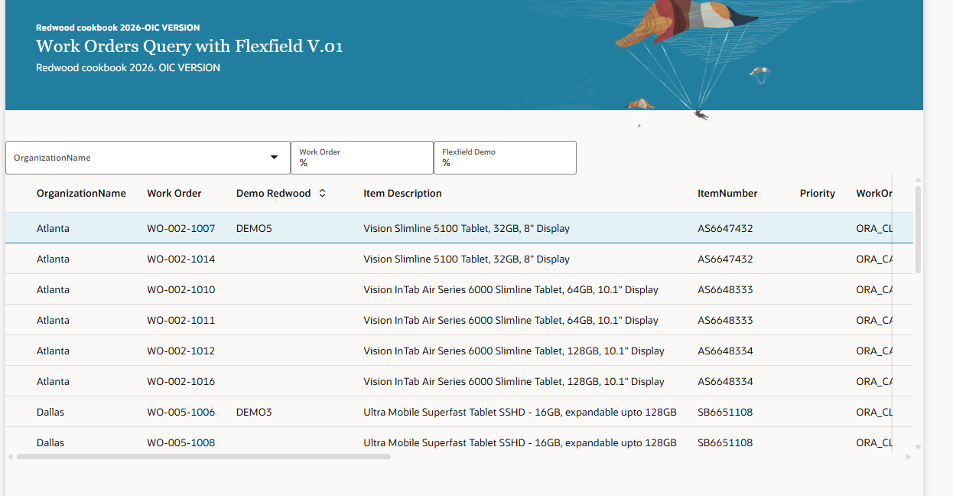
SCM. Work orders. (7)
We have built a page to query Work Orders using flexfield, using both OIC-VB and Fusion-VB.
Example of blind query.

Slide 22
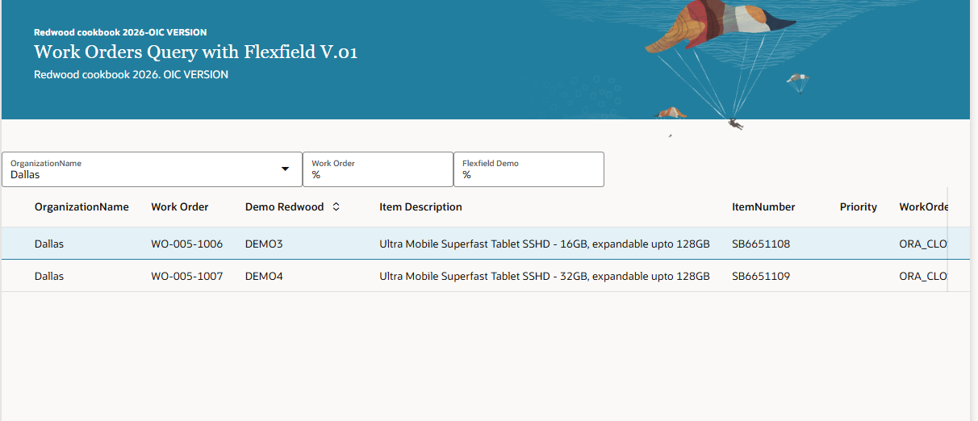
SCM. Work orders. (7)
We have built a page for building a page to query Work Orders using flexfield, using OIC-VB and Fusion-VB.
Example using Business Unit to filter

Slide 23
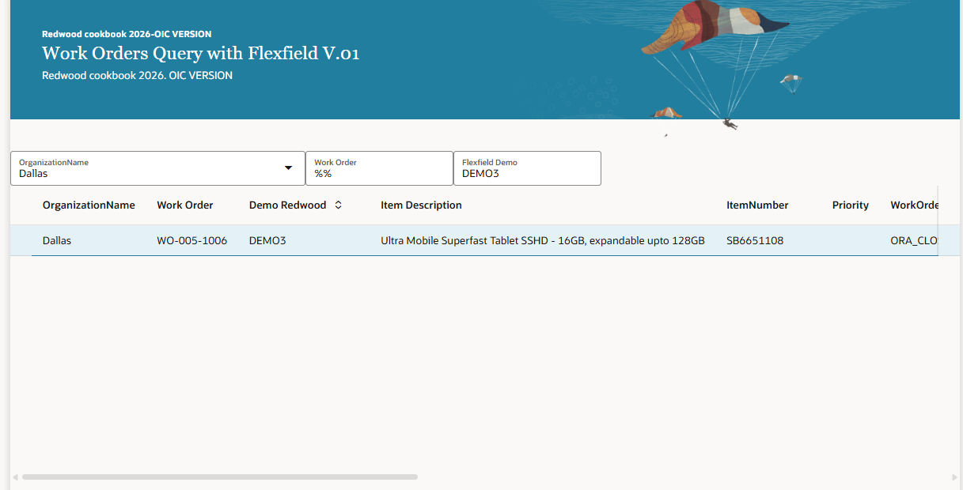
SCM. Work orders. (7)
We have built a page for building a page to query Work Orders using flexfield, using OIC-VB and Fusion-VB.
Example using flexfield to filter.

Slide 24
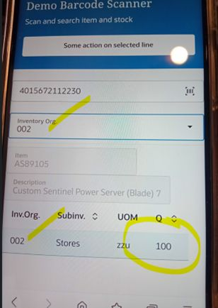
Redwood Custom pages to scan a EAN13 barcode with mobile or PWA device. (8)
Requirements as follows: 1. Scan an item EAN13 barcode. PART I 2. Show stock using REST. PART II (this one). Details: a) Show item+description and b) User will be able to select Inventory Organization to limit the stocks shown

Slide 25
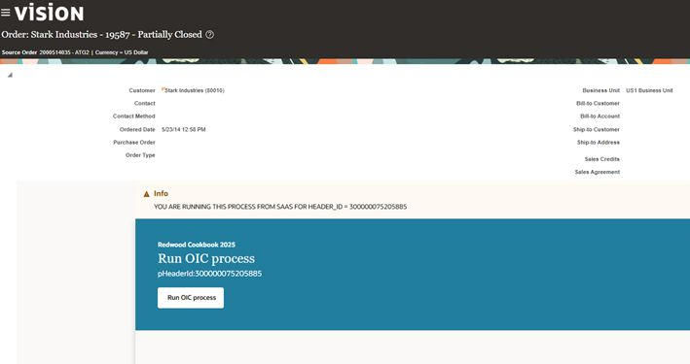
Sales Order. ADF Classic page. Run OIC integration from button. (9)
Oracle SaaS-VB extension with OIC-VB. Classic-ADF SCM Sales Orders. Call OIC integration from button. Redwood CookBook 2026.

Slide 26
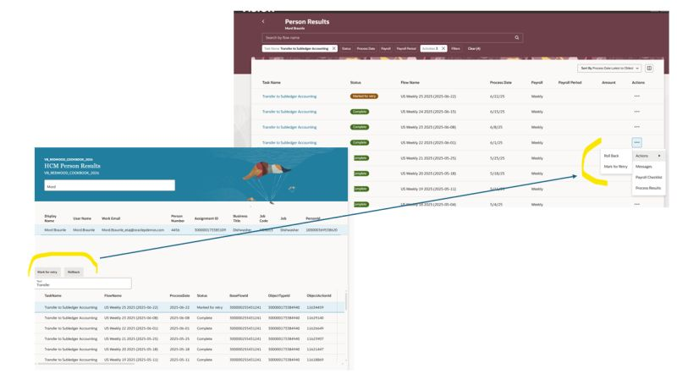
HCM. Person Results. Basic page to show feasibility to clone standard with our requirements. (10)
Oracle Fusion HCM. Basic & limited version of Person Results page. OIC-Visual Builder Redwood application. Redwood Cookbook 2026

Slide 27
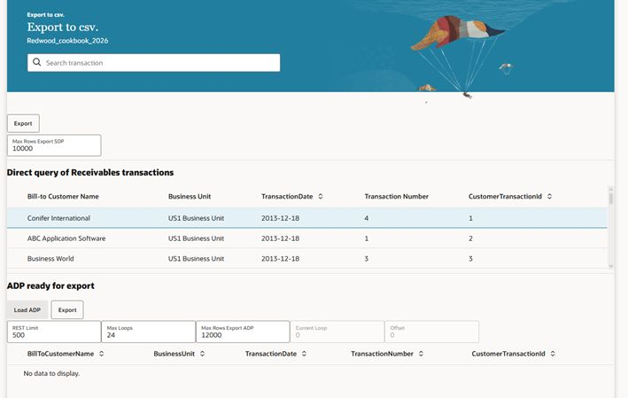
Transactions. Export to csv 10.000+ records. WIP. (11)
Oracle SaaS Redwood SCM-Procurement pages. Redwood Cookbook 2026. Export 10000+ records to csv from any Redwood page. PROBLEM NOT FULLY SOLVED YET. Work in progress…keep reading.

Slide 28
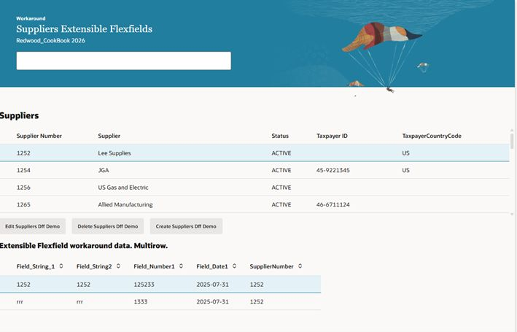
Suppliers. Import and show in Redwood page 500+ UDAs (User defined attributes). (12)
“Migrating suppliers. In EBS-r12 we have 300+ UDAs to capture information related to suppliers. Any idea how to map these UDA in Oracle Erp cloud”.
What can we do? Create our own extensible flexfields using Redwood Visual Builder features.

